Slide 1
Bulgarian Academy of Sciences Economic Research Institute
KNOWLEDGE SHARING PROGRAM (2016-2017 KSP)
Background presentation on Topic 2:
Revitalization of capital market in Bulgaria
based on the Korean experience

Slide 2
OUTLINE
Background of suggested topic No2
Bulgarian capital market history
Bulgarian capital market framework
Recent development: Challenges and prospects
Contributions by:
Prof. Iskra Balkanska
Prof. Tatiana Stefanova
Associate prof. Daniela Bobeva
Dr. Anton Kostadinov

Slide 3
Why capital market is a priority?
The global financial crisis and consequent
economic crises in the EU led to a steep
decline of Bulgarian capital market and slower than expected recovery. Market capitalization dropped down to BGN 9 bn in 2014 and 2015 8,2 bn.
In the last three years only few new companies went public 2013 – 2016 only 3 companies went public Speedy, Sirma group holding and Alterco. 2006 - 7-8; 2007 – 12;
Encouraging private sector companies listing is a problem.
Public knowledge about the capital market opportunities is limited and the interest is marginal.

Slide 4
Why revitalization of capital market?
Large companies very often delist;
The main driver of the capital market was the state by offering shares of SOEs, but this source of dynamics in the capital market development is no more available since SOEs sector contracted substantially after privatization
Still, there are some SOEs in energy, transportation and utilities sectors that may be offered on the stock exchange but this requires thorough preparation and strong political will

Slide 5
Why revitalization of capital market?
The project will have a strong development impact: greater cooperation between Bulgarian and Korean stock exchanges; Possible increase of FDI between the countries.
Strengthening the capital market is one of the policy priorities
While the capital market is tightly regulated by EU regulations new changes in the legal framework expected this year aiming at further development of the market.

Slide 6
Three sectorial topics
Topic One:
Boosting the dynamism of the capital market.
Inducing more promising companies to be listed; differentiated listing suitable for each market, how to attract more promising companies to be listed
Conditions and access of SMEs to the capital market,
Enhancing the trading convenience for investors,

Slide 7
Three sectorial topics
Topic TWO:
The role of the state and the other stakeholders in developing the capital market.
Challenges in listing large state owned enterprises.
Privatization through stock exchange
Cooperation between stakeholders
Legal and Institutional improvements

Slide 8
Three sectorial topics
Topic three
Enhancing the status of the Bulgarian capital market:
primary market promotion instruments
secondary market promotion instruments
strengthening public awareness and motivation in investing by different groups on the capital market

Slide 9
Why Economic Research Institute ?
The Economic Research institute is an academic institution with an in depth focus on the economy
The highest internationally rated Bulgarian research institute in the area of economy
Broad expertise in the financial sector and in capital market
Experience in combining academic research with policy innovation and development
Experience in working with Korean partners: MOU with Korea Institute for Industrial Economics and Trade (KIET) from 2014, Successful project in KSP 2015-2016 “Governance Innovation for SOEs in Bulgaria”; experience in coordinating Bulgarian teams in KSP projects.
Synergies between the last and the new KSP project

Slide 10
Why Economic Research Institute ?
Conferences and seminars on Korea-Bulgaria bilateral economic relations
Research: Stefanova J., Wenner Z., (2016) Adaptation of the Bulgarian Capital market in the Context of the Membership of the Country in the European Union.
ERI gives priority to the research and drawing expertise from Asia. (Resource center for Asian Economies at the ERI-BAS)
The project will have a strong academic impact: broadening the knowledge and expertise in capital market from an international prospective; also enriching the research on Korean and Asian markets;

Slide 11
Why Korean experience?
The longer than expected depression of Bulgarian capital market demands new approaches, new instruments and innovative policies that could help recovering the stock market;
Korean capital market is one of the least effected by the global financial crisis and rapidly developing in the region;
Success in competing with larger neighboring capital markets;

Slide 12
Why Korean experience?
It is remarkable that in spite of global financial markets deterioration in 2014 the KRX succeeded in achieving a 70% increase of IPO companies
Korean experience in encouraging listing of companies is unique and transferable;
Cooperation between the stakeholders is of interest
The changing role of the state in capital market development of Korea and lessons learned

Slide 13
Recent Publications in scientific magazines of Economic Research Institute
Doncho Donev, Application of stock assessment models in Bulgarian stock market
Artur Mitsel, Olga Rekundal, Pension Capital Investment in the Context of a Private Pension Fund
Babajide Abiola Ayopo, Lawal Adedoyin Isola, Somoye Russel Olukayode, Stock Market Volatility: Do Our Fundamentals Matter?

Slide 14
Legal framework of Bulgarian capital market
Public Offering of Securities Act
Markets in Financial Instruments Act
Financial Supervision Commission Act
Commerce Act
Measures Against Market Abuse With Financial Instruments Act
Special Investment Purpose Companies Act
Law on the activities of collective investment schemes and other collective investment undertakings
Privatization and Post-privatization Control Act
Credit Institutions Act
Supplementary Supervision of Financial Conglomerates Act

Slide 15
Participants in Bulgarian Capital Market
Financial Supervision Commission;
Central Depository;
Investment Intermediary companies;
Institutional Investors;
Individual Investors;
Investor Compensation Fund

Slide 16
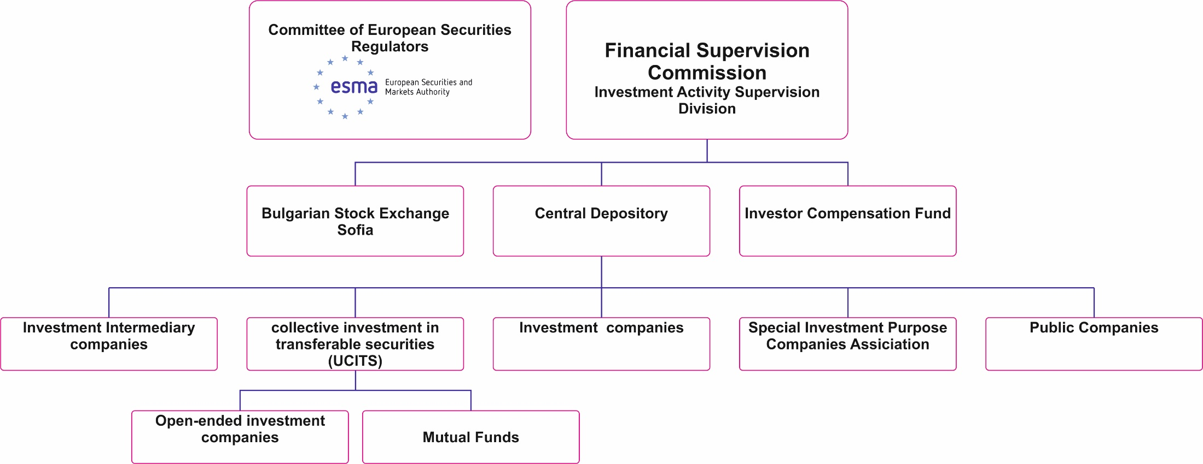
Institutional Framework of Bulgarian Capital Market

Slide 17
History of the Bulgarian stock exchange (BSE) Early years
Bulgarian capital market dates back from the beginning of the 20th century.
The first provisional Stock Exchange Act was adopted in 1907 and regulated the structure and functions of both the stock and commodity exchanges in the country.
On April 15th 1914, under the King's Decree №7 the first real stock exchange, named Sofia Stock Exchange, was established.
Bulgarian stock exchange began its development considerably later than the countries in Western and Central Europe.

Slide 18
History of the Bulgarian stock exchange (BSE) Early years
The first joint stock company in Bulgaria - "Bulgarian commercial company “Providence" was founded in 1862.
In 1917, the Management Board of Sofia Stock Exchange declared a public call to joint-stock companies in Bulgaria to submit a formal request for admission to the Exchange Trading. Besides the request, the companies had to fill a data Prospectus.
Considering that the requirement for prospectuses was introduced after 1990 in Bulgaria, The stock exchange of the ex-Bulgarian Kingdom was established in accordance with the latest trends in the trading with securities.

Slide 19
History of the Bulgarian stock exchange (BSE) Early years
In 1918 and had 56 members - the largest financial and credit institutions in the country and bankers with a total share capital of 390 million Levs.
During the world economic crisis of 1929-1933 the Bulgarian stock exchange has shrunk due to the bankruptcy of a large number of local companies and the low liquidity.
Trading on the Sofia Stock Exchange had been ceased during the period November 1925 -September 1928.
After the end of the world economic crisis, the stock exchange turnover and the liquidity increased and some 30 companies were listed.
In the period 1947 – 1991 Sofia Stock Exchange ceased its operations.

Slide 20
Events after the reinstatement of the BSE
Trading was resumed back in July 1991, and months later was founded a joint-stock company – The First Bulgarian Stock Exchange (PBFB).
In 1992 - 1994 in about 20 Regional stock exchanges were founded.
In 1995 the Law on Securities, Stock Exchanges and Investment Companies was adopted and it gave the framework for the start up of Bulgarian regulated capital market.
According the Law the Commission on Securities and Stock Exchanges was created (Now the Financial Supervision Commission).
At the end of 1995 the Bulgarian Stock Exchange was established, and among the co-founders were the First Bulgarian Stock Exchange, the Plovdiv Stock Exchange, the Black Sea Stock Exchange, the Stock Exchange Danube and Stock Exchange North.

Slide 21
Events after the reinstatement of the BSE
In 1996, the Central Depository was founded - an organisation, carrying settlements of corporate securities. Nowadays, the state continue to be the major owner of the capital of the BSE and the Central Depository.
In 1997 the First procedures rules were adopted giving the basic recommendations for the operation and the functioning of the Stock exchange.
Later on the BSE was licensed by the Commission on Securities and Stock Exchanges and received full right s to function and to operate like a stock exchange market.

Slide 22
Events after the reinstatement of the BSE
1999, the Official Bond Market was established where the first public issue of corporate bonds was issued.
October 20, 2000, the main stock exchange index SOFIX was set up with basic value of 100 pts. It represents the ratio of the sum of the market capitalization of the companies included in deals on the current day and the amounts of their capitalization to the previous day.
In 2003 started the electronic submission of orders through Internet by clients of the members of the stock exchange called COBOS (Client order book online system).

Slide 23
Events after the reinstatement of the BSE
2004: the first initial public offering (IPO) in Bulgaria
2005: 34.78% of the capital of Bulgarian Telecommunications Company (BTC) AD was offered.
2007: two new indexes - BGTR30 and BGREIT.
2007: Framework Agreement for the implementation of the electronic trading system of Deutsche Börse Xetra was signed.

Slide 24
Capital market impact on the Bulgarian economy in the pre-crisis period
In the period before 2005 and the global financial and economic crisis, the Bulgarian stock exchange as a part of the non banking financial sector was relatively under developed.
The importance of non banks financial operations of investments and savings increased significantly, as compared with the previous years, and this respectively increased the importance of the BSE.
The BSE development was a prerequisite for the amelioration of the competition, of the quality and the variety of the offered financial services.

Slide 25
Driving factors for the Capital market development in pre-crisis period
Large offerings of SOEs
the Regulation of the mutual funds,
the Pension reform,
the tax policy,
the increased activity of investors on the market.
The role of the BSE, like an alternative channel for financial intermediation increased.

Slide 26
Capital market impact on the Bulgarian economy in the pre crisis period
An important factor for the development of the BSE was the increase of retail investors’ deals. The relatively simplified procedures, as well as the similarities with the investment companies regulations, made the BSE deals a preferred form of investment capitals’ consolidation for the Managerial public companies.
By the end of 2007, the number of listed companies was 30, which provided an opportunity for a professional management of assets, amounting to a value of BGN 900 millions, managed by 60 Mutual Funds.
However, the volume of the managed assets created some fears that it could be a signal for a systemic risk in periods of corrections and economic downturns.

Slide 27
Capital market impact on the Bulgarian economy in the pre crisis period
The Pension Funds also invest in BSE. By the end of 2007, the volume of pension insurance assets invested in equities reached BGN 664 millions, which represented nearly 30% of their total assets.
In 2005-2007, the commercial banks were active in the investment banking by providing of services, such as underwriters, issuers of debt securities, trustees of the bond holders, depository and custodial services.
The commercial banks offered structured financial products, based on key measures of the BSE evolution of equity prices.

Slide 28
Capital market impact on the Bulgarian economy in the pre- crisis period
Strengthening of the role of banks as institutional investors on the market and attempts for diversification of the financial products on the capital market was observed.
The financial products were structured as financial instruments and listed.
At the end of 2007, foreign investors penetrated the BSE and participated in deals. 41.67% of the market capitalization in the beginning of 2007 was due to foreign investors.
A factor influenced the development of BSE in 2005-2008 was the harmonization of the Bulgarian financial legislation with EU financial regulations.

Slide 29
Capital market impact on the Bulgarian economy in the pre crisis period
At the end of 2007 strong outflows of individual investors funds from mutual funds were observed.
BSE was on strong pressure during the crisis, given the relatively low liquidity of the capital market, the lack of listed companies and the fall of equity prices.
Bulgarian Stock Exchange became a public company in 2010, and the first transaction in securities was in January 2011.

Slide 30
Capital market impact on the Bulgarian economy in post crisis period
During 2013, the market value of listed companies on the main market reached BGN 8.7 billion, and on the alternative segment - about BGN 2.1 billion. At the end of 2013, shares of the stock exchange were trading at levels of BGN 2.50 to BGN 3.47 per share.
A positive trend for BSE deals in 2015- The average dividend yield on stock is around 4%, and the calculated investors dividends amounted at BGN 153 million. The interest rate on banks’ deposits were less than 1%,which makes investments in shares profitable. More than 5 % is the yield of the shares of the most actively traded companies on the BSE.
In 2016, the yield on banks deposits does not give cause for satisfaction and it will not change soon. This opens the opportunities for the capital market to develop . The average expected yield is about 4%.

Slide 31
Capital market impact on the Bulgarian economy in post crisis period
The special purpose vehicles (SPV) are among the companies with the most predictable policy of distribution of dividends, due to their inherent legal obligation to do so.
The yield, those companies bring is above the average for the market.

Slide 32
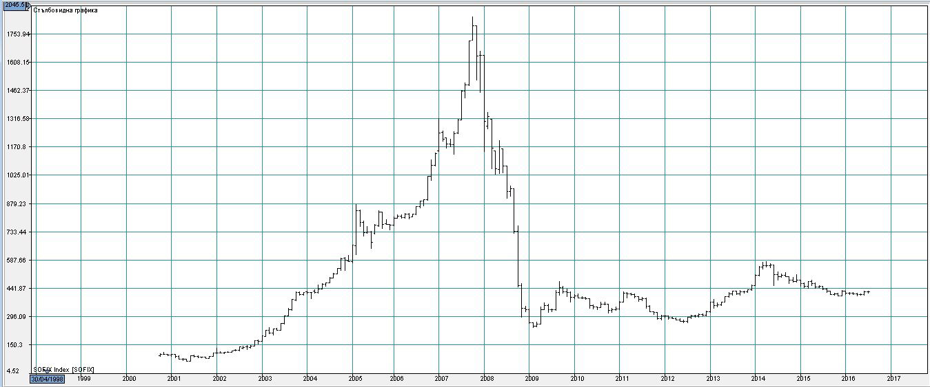
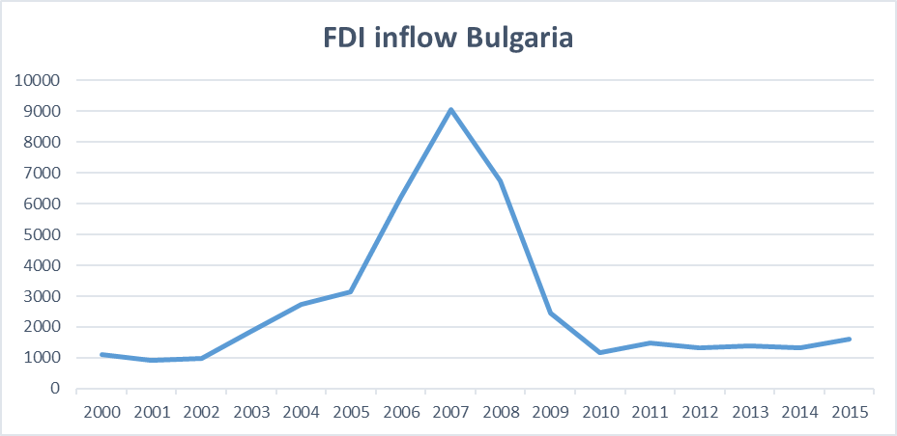
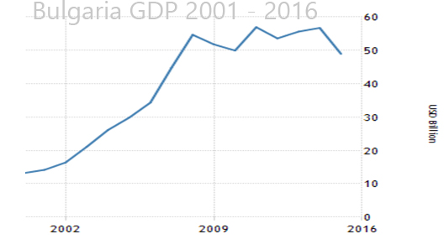
SCE – Sofia Sofix index development 2000 – 2016, Bulgaria GDP – 2001 - 2016 and FDI inflow for Bulgaria 2000-2016

Slide 33
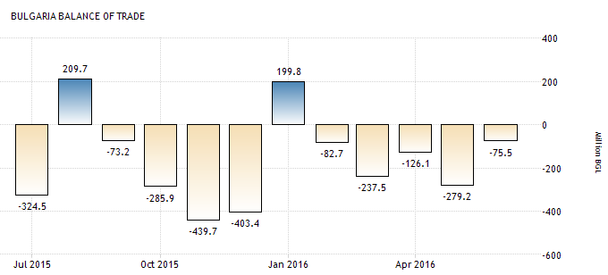
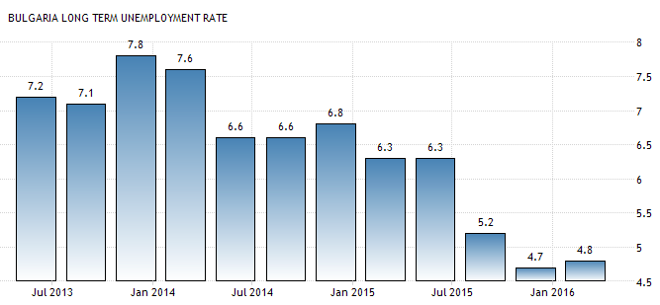
SCE – Sofia Sofix index development 2000 – 2016 and Bulgaria GDP – 2001 - 2016

Slide 34
Main trends and indicators of Capital Market’s Development: Market Capitalization / Gross Domestic Product of Bulgaria
Indicator | 31.Dec.15 | 31.Dec.14
Market Capitalization (mln. BGN) | 8 587 | 9 756
GDP as per BNB data (mln. BGN) | 84 236 | 83 612
Market Capitalization/GDP | 10.19% | 11.67%

Slide 35
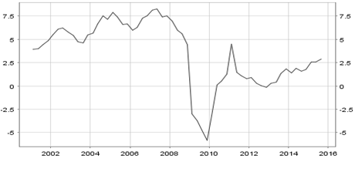
Main Factors for the Present State of the Capital Market in Bulgaria(1) :the Impact of the Global and Euro area financial crisis on the Economic Growth
The Annual Rate of Growth of the GDP of Bulgaria (for (2002 -2015)

Slide 36
Investment In Bulgaria in 2000-2015 (as% of GDP, in total: both public and private)

Slide 37
Main Factors for the Present State of the Capital Market in Bulgaria(2) : main indicators of the slowdown of investment in Bulgaria in 2008-2015

Slide 38
The Impact of the Crisis (3): Fall of Assets of the Mutual Funds as Financial Intermediaries in Bulgaria

Slide 39
Segments of the Bulgarian Stock Exchange
Premium Equities Segment
Standard Equities Segment
Special Purpose Vehicles Segment
Bonds Segment
Compensatory Instruments Segment
Exchange Traded Products Segment
Subscription Rights Segment
Privatization Segment
Initial Public Offering Segment

Slide 40
MARKET CAPITALISATION (by Segments of BSE Market, in Mill.BGN)

Slide 41
The Premium Equities Segment

Slide 42
Listed securities (Listed by domestic companies in case of equity) at the Bulgarian Stock Exchange in 2008-2015 (Quantity in millions BGN)

Slide 43
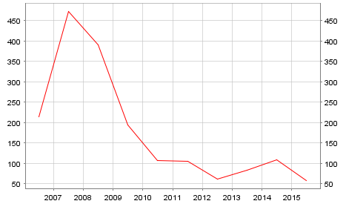
Trade with Securities at the Bulgarian Stock Exchange (Total trade with, Debt securities, equities and other securities) in Millions of Euro)

Slide 44
Number of participants at the Bulgarian Stock Exchange in 2007-2016 (in Number)

Slide 45
INDICES of the Bulgarian Stock Exchange (in %, annual change)
Index | 31.Dec.15 | 31.Dec.14 | Change
SOFIX | 460.90 | 522.10 | -11.72%
BGBX 40 | 92.82 | 104.61 | -11.27%
BG TR30 | 383.82 | 407.50 | -5.81%
BG REIT | 97.03 | 98.75 | -1.74%

Slide 46
Thank you for your attention

